Slide 1
Time & Labor MANAGEMENT LEVEL EMPLOYEES Sharon K. Hill - Director, Human Resources Beth Burns – Assistant Director of Human Resources

Slide 2
What Will We Cover
What is Fair Labor Standards Act (FLSA)
What is Time and Labor (T&L)
Employee/Manager Self Services
Types of Timesheets
Elapse Punch
The Timesheet
Accessing Timesheet
Entering Leave Taken Hours
Leave Balances
Accrued Hours
Adding Rows
Holidays
Change Date
Exception Tab
Payable Time
Approving Leave Hours, Comp Time,
Hours Worked
Important Things to Remember

Slide 3
TeamWorks Time & Labor
What is Fair Labor Standards Act (FLSA)
FLSA is a federal law which establishes:
Minimum wage
Overtime pay eligibility
Recordkeeping
Child labor standards

Slide 4
TeamWorks Time & Labor
What is Fair Labor Standards Act (FLSA)
Along with overtime pay eligibility, FLSA gives employers guidelines on Exempt VS Nonexempt employment categories
Nonexempt employees are entitled to overtime pay and/or Comp. time
Exempt employees are not entitled to overtime pay and/or Comp. time
Exempt or nonexempt depends on:
How much one is paid (salary level test)
How one is paid (salary basis test)
What kind of work one does (duties test)

Slide 5
Employee Self-Service
Time Reporting via Time Sheet
Leave Request via Time Sheet
Ability to review summary totals for selected time period
Ability to review leave balances as of the end of previous time period, while in the selected time period, including details
Leave accruals for annual and sick earned on the last day of the month show on the time sheet
Holiday Hours earned and Holiday Taken on the time sheet

Slide 6
Manager Self-Service
Enter, View, or Change Employee Reported Time/Leave
Ability to review summary totals for selected time period
Ability to review leave balances as of the end of previous time period, while in the selected time period, including details
Holiday Hours earned and Holiday Taken on the time sheet
Approve, Deny, or Send/Push Back Employee Reported Time/Leave

Slide 7
Elapse Timesheet - Reporting Leave
Used by Exempt/Non exempt salaried employees
Reports Leave Hours Taken (hrs./mins.)
Does not enter work hours or clock times

Slide 8
Sample Elapsed Time Sheet

Slide 9
Punch Timesheet Reporting Work Hours
Used by part-time employees
Enters all work hours or clock hours
Non-Exempt/Exempt Salaried Employees (FLSA eligible)
Enters all compensatory time

Slide 10
Sample Punch Time Sheet

Slide 11
How To Access My Timesheet
SELF SERVICE > TIME REPORTING > REPORT TIME > TIMESHEET
Your current timesheet will be displayed.
To display other timesheets, use one of the following options:
Click the either Previous Period or Next Period link to display timesheet

Slide 12
Elapsed Time Sheet

Slide 13
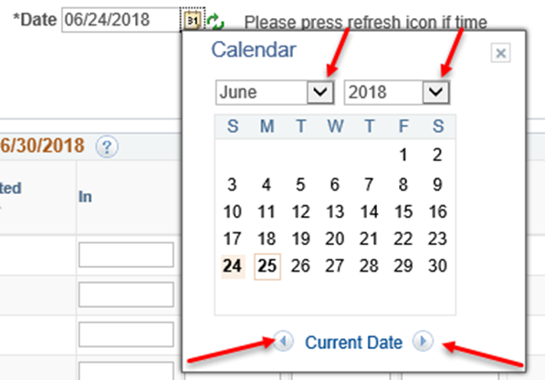
How To Access My Timesheet
Click the Calendar icon next to the Date field. The current month’s calendar will be displayed.
Use the Month, Year and Month
drop down arrows to display time
period.
Click on a date in the timesheet
period you wish to display
The selected timesheet will be displayed

Slide 14
How to Enter Leave Taken Hours
Leave/Comp Time Taken hours entered directly timesheet
Requires manager approval
System edits hours to ensure hours are available when entering Leave/Comp Time Taken hours
Includes current balance, any unapproved entries in the past and future entries, both approved and unapproved, in the calculation for determining if the hours are available

Slide 15
Elapsed Time Sheet

Slide 16
Leave Balances
Adjustments made by Central Administrators.
Adjustments are greyed out
Employees nor managers have access to edit balance adjustments.
Leave Taken and Comp Time Taken will be applied to the appropriate balance and can be viewed on the next timesheet.
Click Leave/Comp Time tab at the bottom of the timesheet to view Leave and Comp Time balances.

Slide 17
When Will Leave Taken Hours Be Reduced From My Balance?
Leave/Comp Time Balances are displayed in the Leave/Comp Time tab
Approved Leave adjustments including accruals, are processed nightly
Balances are displayed on timesheet for next time period

Slide 18
Leave / Comp Time Tab
Leave/Comp Time tab is at bottom of timesheet
Click “View Details” to view details of Leave/Comp Time
Click “Actual Date” to change order of the details
Click “Arrow” and Last link to display other pages, if applicable

Slide 19
Example of Leave and Comp Time Balances

Slide 20
Leave / Comp Time Tab

Slide 21
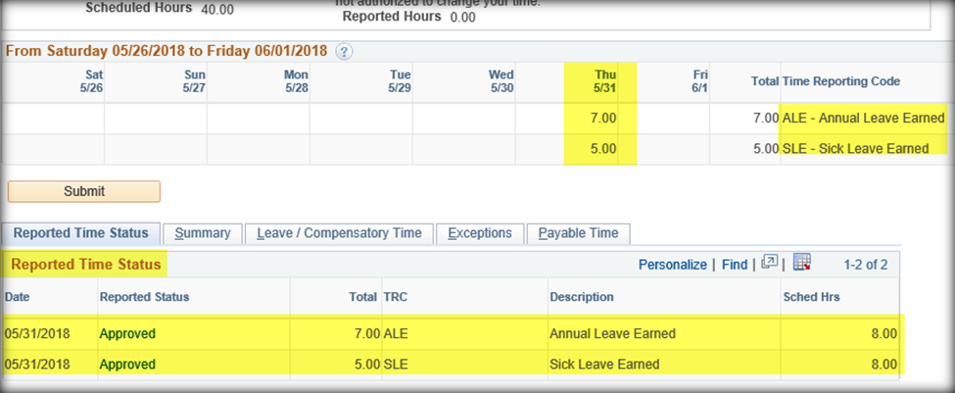
How To See Accrued Hours
Accrued leave hours are inserted last day of the month. It will be greyed out and will not allow any edits.

Slide 22
Adding a Row on Timesheet
Example of 8 hours of Annual Leave Taken

Slide 23
Adding a Row on Timesheet
Click “Add” button to insert new row on timesheet
Click empty field and enter hours/minutes taken
Click “magnifying glass” by Leave Reason
Click SUBMIT

Slide 24
Holidays
– Holiday Leave Earned (HLE) for 8 hours
SCTC’s holidays:
Are built in the system
Will be greyed out
Will not be editable

Slide 25
Earliest Change Date
Displayed at the top of the timesheet
Represents the date Time Administration begins processing
Updates the Earliest Change Date

Slide 26
Exceptions Tab
Located at the bottom of the timesheet
Incomplete data entry, invalid data entry or entry resulting in negative balance
PAYABLE TIME IS UNABLE TO PROCESS WITH EXCEPTIONS!! BALANCES ARE NOT UPDATED !!!
Corrections must be made and resubmitted to managers for approval

Slide 27
Exceptions Tab

Slide 28
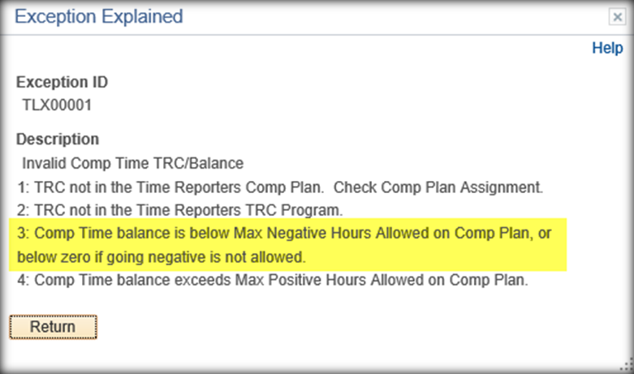
Exceptions Tab
Click on the Explanation link to see detail information about the Exception

Slide 29
Payable Time Tab
Displays results of time processed for each employee and creates Payable Time
Located at bottom of the timesheet

Slide 33
Important Things to Remember
Part-Time Hourly employees including Federal Work Study students
Hourly Pay period runs from the 16th of the month to the 15th
Submit hours worked by COB each Monday for the previous week
Approve employee work hours and Comp Time hours by COB each Tuesday
APPROVED HOURLY EMPLOYEES HOURS WORKED OR THEY WILL NOT GET PAID!!!!
Responsible for the accuracy of employee hours, not Human Resources

Slide 34
Important Things to Remember
Non Exempt/Exempt FLSA employees
All non-exempt, salaried (FLSA Eligible) employees and hourly employees are required by law to report time
Comp Time hours must be utilized prior to using Leave Time and as soon as possible
All Comp Time hours must be used prior to the end of each fiscal year
Managers are responsible for the accuracy of employee hours, not Human Resources

Slide 35
Important Things to Remember
Exempt Level Employees
Submit all Leave Requests through Time & Labor
Approve Leave Time by end of each month

Slide 36
QUESTIONS????
Beth Ogletree – Time Administrator
Jonathan Brown - Payroll Coordinator

