Slide 1
Time & Labor PART-TIME HOURLY EMPLOYEES Sharon K. Hill - Director, Human Resources Beth Burns – Assistant Director, Human Resources

Slide 2
What Will We Cover
What is Fair Labor Standards Act (FLSA)
Employee Self Services
The Timesheet
Punch Timesheets
Accessing Timesheet
Hours Worked
Lunch/No Lunch Hours
Multiple Sessions in one day
Work Crosses Midnight
Holidays
Important Things to Remember

Slide 3
Employee Self-Service
Time Reporting via Time Sheet
Ability to review summary totals for selected time period
Review Pay Stub
Update/Change state and federal tax withholdings
Update/Change home address
Update emergency contacts

Slide 4
Punch Timesheet Reporting Work Hours
Used by part-time employees
Enters all work hours or clock hours for payable time.
THIS IS HOW YOU WILL GET PAID!!!!!!

Slide 5
Sample Punch Time Sheet

Slide 6
How To Access My Timesheet
SELF SERVICE > TIME REPORTING > REPORT TIME > TIMESHEET
Your current timesheet will be displayed.
To display other timesheets, use one of the following options:
Click the either Previous Period or Next Period link to display timesheet

Slide 7
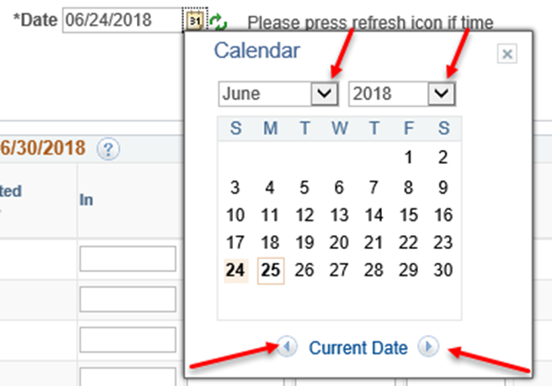
How To Access My Timesheet
Click the Calendar icon next to the Date field. The current month’s calendar will be displayed.
Use the Month, Year and Month
drop down arrows to display time
period.
Click on a date in the timesheet
period you wish to display
The selected timesheet will be displayed

Slide 8
ENTERING HOURS WORKED
Must enter all hours worked
Click in your arrival time, lunch time, return from lunch and then your departure time in each block
Click Time Reporting Code – Regular Pay
Click SUBMIT

Slide 9
ENTERING HOURS WORKED
Saves your entries
Changes Reported Status to Needs Approval
Updates your Reported Hours on top of timesheet
Manager has ability to approve your time!

Slide 10
Entering Hours – No lunch
Click First Punch In field - Enter Start time
Click Punch Out field Enter Stop time
Click Drop-down arrow for the Time Reporting Code select REG – Regular Pay
Click SUBMIT button to save your entries

Slide 11
Entering Hours – No lunch
The following is an INCORRECT example:

Slide 12
Work Time for Multiple Sessions in a Single Day
Click First Punch In Enter Start time
Click Lunch Enter Lunch period begins
Click Second Punch In Enter Return from Lunch period
Punch Out Enter time stopped working
Click Drop-Down arrow for Time Reporting Code - Select REG – Regular Pay
Scroll to the right Click Add icon to add a new row for the date
On the new row, Click First Punch In Enter Start time for next session
On the new row, Click Punch Out Enter time stopped working
Click the Drop-Down arrow for Time Reporting Code - Select REG – Regular Pay
Click the Submit button to save your entries

Slide 13
Work Time for Multiple Sessions in a Single Day

Slide 14
Important Things to Remember
Part-Time Hourly employees including Federal Work Study students
Hourly Pay period runs from the 16th of the month to the 15th
Submit hours worked by COB each Monday for the previous week
Managers must approve employee work hours by COB each Tuesday
YOU WILL NOT GET PAID!!
IF YOU DO NOT SUBMIT YOUR HOURS WORKED ON TIME
IF YOUR MANAGER DOES NOT APPROVE YOUR HOURS WORKED ON TIME

Slide 15
QUESTIONS????
Beth Burns– Time Administrator
Jonathan Brown - Payroll Coordinator

