Slide 1
Time & Labor EXEMPT/NON-EXEMPT LEVEL EMPLOYEES Sharon K. Hill - Director, Human Resources Beth Burns – Assistant Director, Human Resources

Slide 2
What Will We Cover
What is Fair Labor Standards Act (FLSA)
What is Time and Labor (T&L)
Employee Self Services
Types of Timesheets
Elapse Punch
The Timesheet
Accessing Timesheet
Entering Leave Taken Hours
Leave Balances
Accrued Hours
Adding Rows
Holidays
Change Date
Exception Tab
Payable Time
Important Things to Remember

Slide 3
TeamWorks Time & Labor
What is Fair Labor Standards Act (FLSA)
FLSA is a federal law which establishes:
Minimum wage
Overtime pay eligibility
Recordkeeping
Child labor standards

Slide 4
TeamWorks Time & Labor
What is Fair Labor Standards Act (FLSA)
Along with overtime pay eligibility, FLSA gives employers guidelines on Exempt VS Nonexempt employment categories
Nonexempt employees are entitled FLSA Comp. time
Exempt employees are not entitled to FLSA Comp. time
Exempt or nonexempt depends on:
How much one is paid (salary level test)
How one is paid (salary basis test)
What kind of work one does (duties test)

Slide 5
Employee Self-Service
Time Reporting via Time Sheet
Leave Request via Time Sheet
Ability to review summary totals for selected time period
Ability to review leave balances as of the end of previous time period, while in the selected time period, including details
Leave accruals for annual and sick will be viewable on the time sheet at the end of the month
Holiday Hours earned and Holiday Taken on the time sheet

Slide 6
Elapse Timesheet - Reporting Leave
Used by Exempt salaried employees
Reports Leave Hours Taken (hrs./mins.)
Does not enter work hours or clock times

Slide 7
Sample Elapsed Time Sheet

Slide 8
Punch Timesheet Reporting Work Hours
Used by all part-time employees
Enters all work hours or clock hours
Non-Exempt (FLSA eligible)
Enters all compensatory time and leave

Slide 9
Sample Punch Time Sheet

Slide 10
How To Access My Timesheet
SELF SERVICE > TIME REPORTING > REPORT TIME > TIMESHEET
Your current timesheet will be displayed.
To display other timesheets, use one of the following options:
Click the either Previous Period or Next Period link to display timesheet

Slide 11
Elapsed Time Sheet

Slide 12
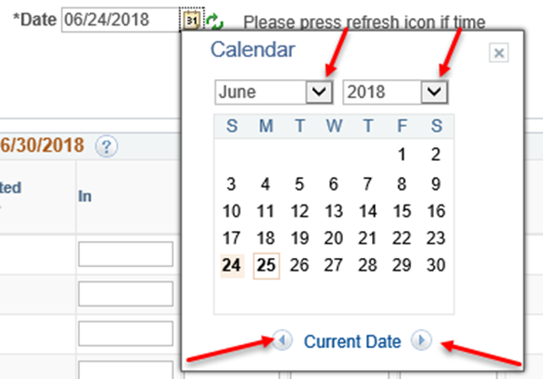
How To Access My Timesheet
Click the Calendar icon next to the Date field. The current month’s calendar will be displayed.
Use the Month, Year and Month
drop down arrows to display time
period.
Click on a date in the timesheet
period you wish to display
The selected timesheet will be displayed

Slide 13
How to Enter Leave Taken Hours
Leave/Comp Time Taken hours entered directly timesheet
Requires manager approval
System edits hours to ensure hours are available when entering Leave/Comp Time Taken hours
Includes current balance, any unapproved entries in the past and future entries, both approved and unapproved, in the calculation for determining if the hours are available

Slide 14
Elapsed Time Sheet

Slide 15
Entering Leave
Example of 8 hours of Annual Leave Taken

Slide 16
Adding a Row on Timesheet
Click “Add” button to insert new row on timesheet
Click empty field and enter hours/minutes taken
Click “magnifying glass” by Leave Reason
Click SUBMIT

Slide 17
Leave Balances
Click Leave/Comp Time tab at the bottom of the timesheet to view Leave and Comp Time balances
Adjustments are greyed out
Employees nor managers have access to edit balance adjustments
Leave Taken and Comp Time Taken will be applied to the appropriate balance and can be viewed on the next timesheet
Adjustments made by TL Central Administrator

Slide 18
When Will Leave Taken Hours Be Reduced From My Balance?
Balances are displayed on timesheet for next time period
Leave/Comp Time Balances are displayed in the Leave/Comp Time tab
Approved Leave adjustments including accruals, are processed nightly
Adjustments are not made until the leave has been taken

Slide 19
Leave / Comp Time Tab
Leave/Comp Time tab is at bottom of timesheet
Click “View Details” to view details of Leave/Comp Time
Click “Actual Date” to change order of the details
Click “Arrow” and Last link to display other pages, if applicable

Slide 20
Leave / Comp Time Tab

Slide 21
Example of Leave and Comp Time Balances

Slide 22
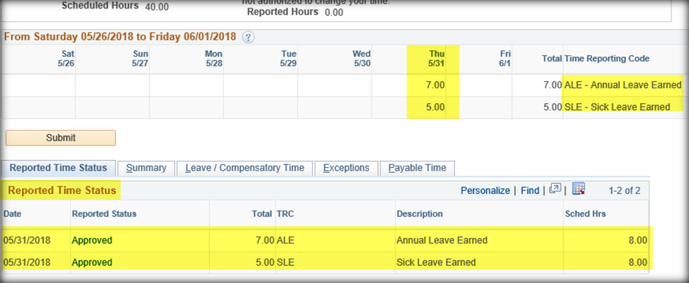
How To See Accrued Hours
Accrued leave hours are inserted last day of the month. It will be greyed out and will not allow any edits.

Slide 23
Holidays
– Holiday Leave Earned (HLE) for 8 hours
SCTC’s holidays:
Are built in the system
Will be greyed out
Will not be editable

Slide 24
Earliest Change Date
Displayed at the top of the timesheet
Represents the date Time Administration begins processing
Updates the Earliest Change Date

Slide 25
Exceptions Tab
Located at the bottom of the timesheet
Incomplete data entry, invalid data entry or entry resulting in negative balance
PAYABLE TIME IS UNABLE TO PROCESS WITH EXCEPTIONS!! BALANCES ARE NOT UPDATED !!!
Corrections must be made and resubmitted to managers for approval

Slide 26
Exceptions Tab

Slide 27
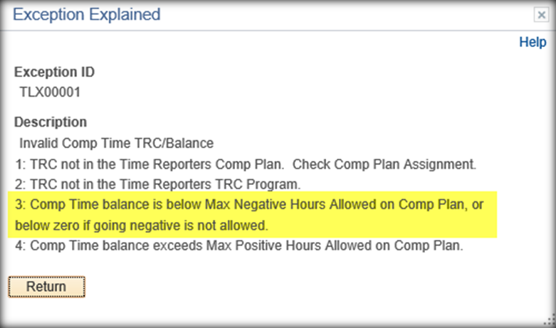
Exceptions Tab
Click on the Explanation link to see detail information about the Exception

Slide 28
Payable Time Tab
Displays results of time processed for each employee and creates Payable Time
Located at bottom of the timesheet

Slide 29
Corrections Needed on Timesheet
Employee should notify manager that change has been made

Slide 30
Important Things to Remember
Exempt Level Employees
Submit all Leave Requests through Time & Labor
Notify your manager prior to taking leave via email, once approved, then enter leave time in the Time and Labor System.

Slide 31
Sample Punch Time Sheet

Slide 32
How To Access My Timesheet
Click the Calendar icon next to the Date field. The current month’s calendar will be displayed.
Use the Month, Year and Month
drop down arrows to display time
period.
Click on a date in the timesheet
period you wish to display
The selected timesheet will be displayed

Slide 33
ENTERING HOURS WORKED
Must enter all hours worked
Click in your arrival time, lunch time, return from lunch and then your departure time in each block
Click Time Reporting Code – Regular Pay
Click SUBMIT

Slide 34
ENTERING HOURS WORKED
Saves your entries
Changes Reported Status to Needs Approval
Updates your Reported Hours on top of timesheet
Manager has ability to approve your time!

Slide 35
Entering Hours – No lunch
Click First Punch In field - Enter Start time
Click Punch Out field Enter Stop time
Click Drop-down arrow for the Time Reporting Code select REG – Regular Pay
Click SUBMIT button to save your entries

Slide 36
Entering Hours – No lunch
The following is an INCORRECT example:

Slide 37
Work Time for Multiple Sessions in a Single Day
Click First Punch In Enter Start time
Click Lunch Enter Lunch period begins
Click Second Punch In Enter Return from Lunch period
Punch Out Enter time stopped working
Click Drop-Down arrow for Time Reporting Code - Select REG – Regular Pay
Scroll to the right Click Add icon to add a new row for the date
On the new row, Click First Punch In Enter Start time for next session
On the new row, Click Punch Out Enter time stopped working
Click the Drop-Down arrow for Time Reporting Code - Select REG – Regular Pay
Click the Submit button to save your entries

Slide 38
Work Time for Multiple Sessions in a Single Day

Slide 39
Important Things to Remember
Part-Time Hourly employees including Federal Work Study students
Hourly Pay period runs from the 16th of the month to the 15th
Submit hours worked by COB each Monday for the previous week
Managers must approve employee work hours by COB each Tuesday
YOU WILL NOT GET PAID!!
IF YOU DO NOT SUBMIT YOUR HOURS WORKED ON TIME
IF YOUR MANAGER DOES NOT APPROVE YOUR HOURS WORKED ON TIME

Slide 40
Important Things to Remember
Non Exempt/Exempt FLSA employees
All non-exempt, salaried (FLSA Eligible) employees are required by law to report time
Comp Time hours must be utilized prior to using Leave Time and as soon as possible
All Comp Time hours must be used prior to the end of each fiscal year
You are responsible for the accuracy of employee hours, not Human Resources

Slide 41
QUESTIONS????
Beth Burns – Time Administrator
Jonathan Brown- Payroll Coordinator

