Slide 1
New Concur Users
**Getting Started**

Slide 2
Access ESS and Employee Expense Reimbursements
Change Employee Expense Reimbursement Information
Log into Concur
Reset Password
Profile Set-up
Personal Car Mileage
Using a Personal Automobile
Lodging
Flights
Meals
News Across the Crescent

Slide 3
Access ESS and Employee Expense Reimbursements

Slide 4
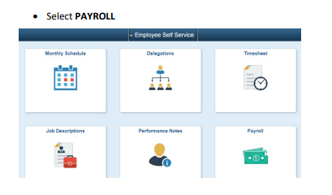
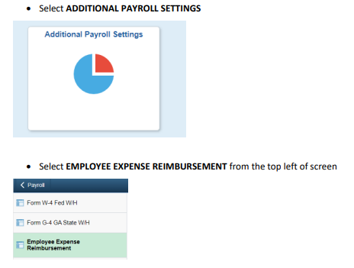

Slide 5
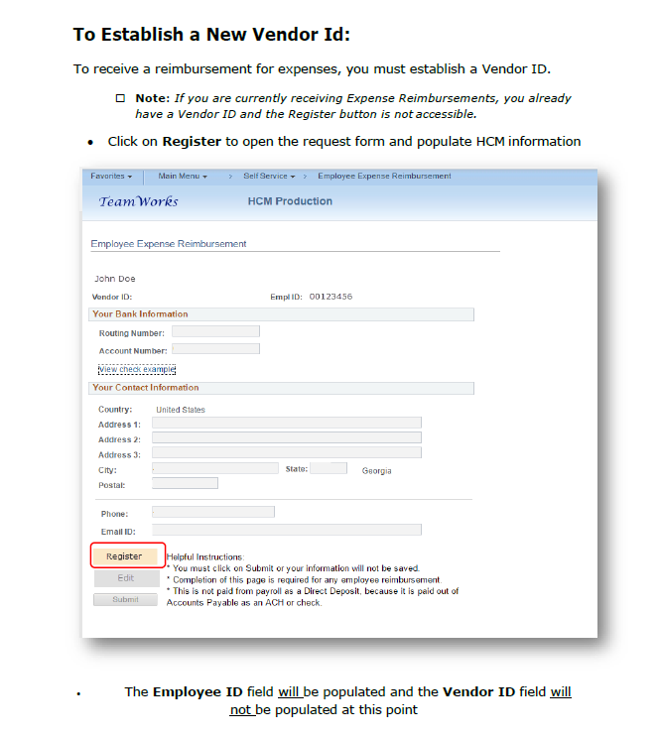

Slide 8
To change Employee Expense Reimbursement contact information:

Slide 9
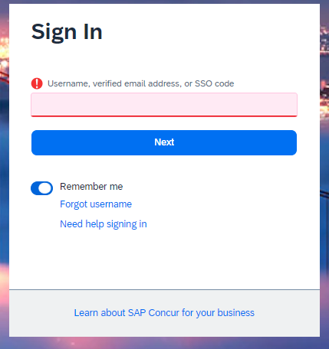
Log into Concur
Website: www.concursolutions.com
Your login ID is your employeeID@sog.ga.gov (00123456@sog.ga.gov)

Slide 10
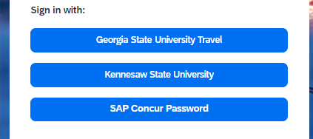
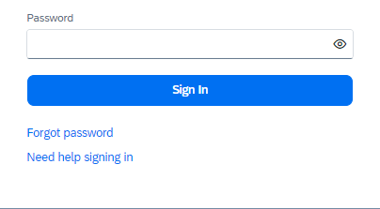
Reset Password
Enter ID and click Next
Select SAP Concur Password
If signing in for the first time, click “Forgot Password”
Reset password using the emailed link

Slide 11
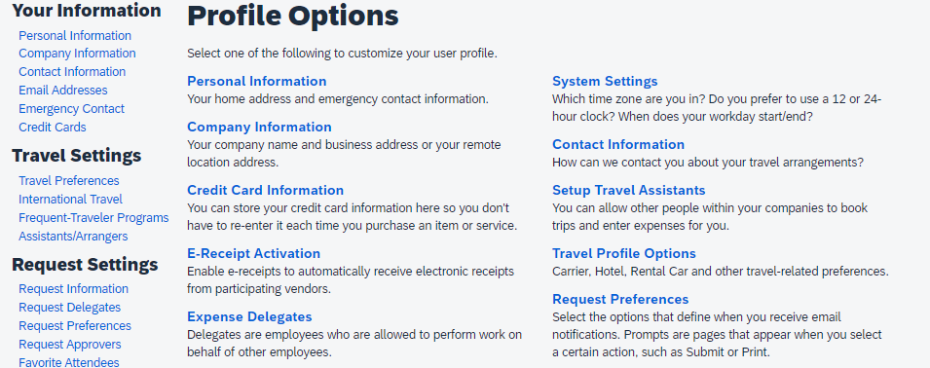
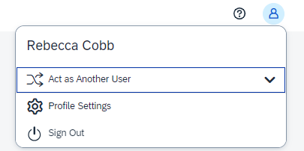
Profile Set-Up
Click on the Profile picture in the upper right corner
Choose Profile Settings
Enter you Personal, Company, and Contact information

Slide 12
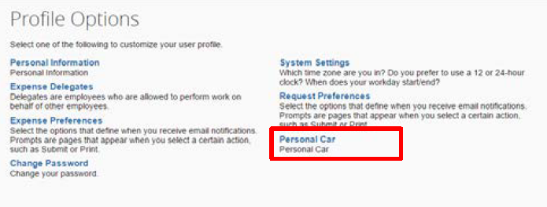
Personal Car Mileage
Click on Personal Car from Profile Settings
Select New
Enter Personal Car-Tier 1 in Vehicle ID field
Select Car-Tier 1 from Vehicle Type
Click Save

Slide 13
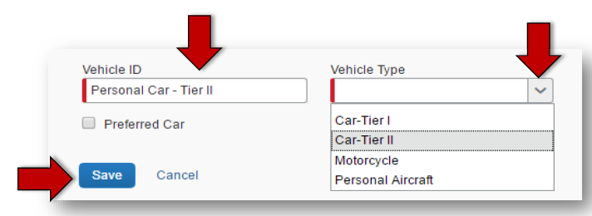
Repeat steps to add Personal car-Tier 2
Click to make Tier 2 a Preferred Car
You will now have access to both Tier 1 and Tier 2 Personal Car Mileage reimbursement rates

Slide 14
Using a Personal Automobile
Reimbursements for business use of a personally-owned vehicle is calculated per business-use mile, from point of departure to point of arrival, including any way-points and deducting actual commute mileage, as applicable.
Reimbursement rates are set by the State:
Tier I reimbursement - When a college vehicle is requested but unavailable. Must submit Vehicle Reservation Form online prior to travel and submit email from Facilities & Operations declining the request as an attachment to expense report. Access Vehicle Reservation Form at NATC-Employees-Forms.
Tier II reimbursement - When a college vehicle is available, but a personal vehicle is used.
Current rates for calendar year 2024:
TIER 1 Automobile: $0.67/mile
TIER 2 Automobile: $0.21/mile

Slide 15
Lodging
Lodging should be booked through Concur unless the hotel has reserved rooms at a group rate for a specific event. Book through the hotel to receive the group rate, but put a comment in your expense report explaining why Concur was not used.
Lodging is an out-of-pocket expense that is reimbursed after submitting an Expense report

Slide 16
Flights
Flights are billed to the College
No out-of-pocket expense
Book through Concur or call our travel agent, Travel Inc, to book
770-291-5190 or 877-548-2996
Email – SOG@travelinc.com

Slide 17
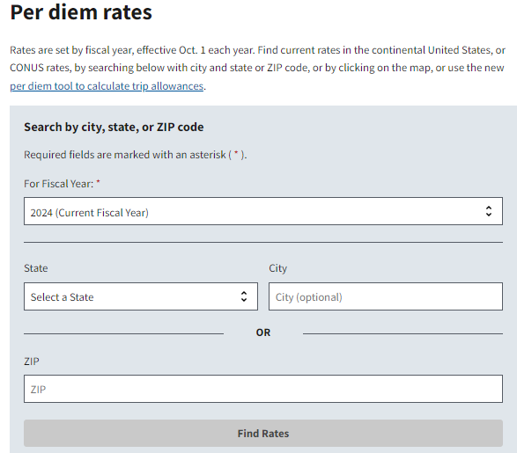
Meals
Meals are paid as a Per Diem for overnight travel
In-State meal per diem is $50 per day: B=$13/L=$14/D=$23,
Provided meals are not reimbursable
Meals for travel days (first and last days of trip) are calculated at 75% of the daily per diem, less rates for provided meals
Out-of-State meal Per Diems are calculated based on trip destination
www.gsa.gov/travel/plan-book/per-diem-rates

Slide 18
News Across the Crescent Travel & Concur Section
Review the Statewide Travel Policy
Sales tax exemption form
GA Hotel tax exemption form
Out-of-State Travel Authorization
How-to documents
Training videos
SCTC contact information

Slide 19
Questions??

